Slide 1
Disclaimer
Please DO NOT REMOVE INFORMATION from this presentation. The information provided in this presentation is valuable for all surface operations.
ADD local information (if needed) to this presentation to ensure it meets your local Sector/District requirements.

Slide 2
Welcome
This is the 2024 Surface Workshop
  ~ we will start on time ~
If you are attending virtually, un-mute your microphone, turn on your camera and say hello to your shipmates
If you have any connectivity problems please call, text, or Email the course facilitator, facilitator name at facilitator phone # or facilitator email.
If you lose connectivity during the session, we suggest you restart your computer before re-entering the session

Slide 3
2024 Surface Operations
Required Workshop
Surface Division
National Response Directorate
Revised 26 Feb 2024 with release of the updated Auxiliary Boat Crew Qualification Handbook – Boat Crew (ABQH) &
Auxiliary Training Handbook Boat Crew (ATH)
Notes:
Welcome the members.

Slide 4
2024 Operations Workshop Topics
Safety
Annual Currency Tasks
Staying out of REYR/REWK
Auxiliary Training Handbook – Boat Crew (ATH-BC)
Auxiliary Boat Crew Qualification Handbook (ABQH)
Evaluation Drill Sheets
Color and Vision Check Video
AUX Operations Process Guide – Vol 1

Slide 5
2024 Operations Workshop Topics
Crew Endurance Management
Mishaps
Standard Auxiliary Maintenance Allowance (SAMA)
AUX Scout
+Local information (if any)
Response Directorate Articles
Surface Contacts/POCs

Slide 6
Ground Rules
This workshop should be interactive, not all lecture
  Ask questions
  Answer questions
  Share experiences
  Share insights
Participate ~ Participate ~ Participate
Notes:
Stress the importance of participation

Slide 7
Safety is ALWAYS the 1st Priority
The CREW
The PUBLIC
And the VESSEL
are MORE IMPORTANT
than the Mission
Notes:
First and Foremost, make sure everyone is safe. Risk management is a way of life. Discuss how we use RM in our everyday lives – crossing a street.

Slide 8
“I’M SAFE“
Am I fit for the mission?
I'
Illness - Do I have an illness or symptoms of illness?
M
Medication - Am I taking prescription or over-the-counter drugs?
S
Stress - Am I under psychological pressure from the job? Worried about financial matters, health problems, or family discord?
A
Alcohol/Drug Use - Have I been drinking within twelve hours? Have I taken any medication which may impact my abilities?
Note: Marijuana & derivatives are not legal for use under federal law
F
Fatigue - Am I tired and not adequately rested?
E
Eating - Am I adequately nourished and hydrated?
Notes:
Auxiliarists shall not consume alcoholic beverages on any mission. Auxiliarists are restricted from missions for 12 hours after last alcohol use and must have no residual effects. This includes the use of “low” and “no” alcohol beverages. Residual effects include light-headedness, headache, sleepiness, fatigue, nausea, and lack of alertness. A zero-alcohol level is essential for personnel to meet the demands of a mission.
Coast Guard missions are conducted under federal jurisdiction and marijuana use is prohibited under federal law.
The use of prescribed or over-the counter (OTC) medications which may diminish the ability of an Auxiliarist to function safely are prohibited. The responsibility for advising the COXN/OIA of any medications having possible adverse side effects, lies solely on the members who are taking the drugs/medications.

Slide 9
Task Requirements – CREW & COXN
INITIAL:
For a member’s initial qualification, they must meet all the requirements in the appropriate PQS and pass the QE checkride.
There is no requirement to separately submit an Annual Currency Maintenance Task Tracker in the calendar year of initial qualification only.
NIGHT:
Member’s that want to be nighttime certified and perform nighttime operations, completion of (MOB and Navigation Exercise) task must be completed at night prior to completion of the PQS process and requesting a QE checkride.
For candidates wanting to be “Night Certified” (MOB and Navigation Exercise) must be part of the QE checkride conducted at night.
Member’s NOT requesting to be “Night Certified” are NOT required to complete the (MOB and Navigation Exercise) requirements at night as part of the qualification process to complete the PQS. THEY MUST COMPLETE THESE TASK DURING DAY to complete the PQS.
Notes:
This information is included in Revision C of the Auxiliary Boat Crew Qualification Handbook, ABQH 16794.52 (series) and Auxiliary Training Handbook – Boat Crew. 16794.51 (series).

Slide 10
Currency Task Requirements
Currency maintenance requirements consist of the follow:
(01) Annual underway tasks
(02) Annual underway hours
(03) Three Year Evaluation by a QE
(04) TCT/RM (15 months)
(05) Navigations Rules exam (5 years)
Reference: Auxiliary Training Handbook – Boat Crew (ATH-BC) - Chapter 5 for detailed currency maintenance requirements for crew member, coxswain, and PWC operator.
Notes:
Every member is responsible to make sure all tasks are properly recorded. You don’t want to wind up in “REYR” or “REWK” because something wasn’t properly reported.

Slide 11
Annual Currency Task Requirements
Annual Currency Maintenance Task Tracker (Enclosure 4, 5, or 6 in the Auxiliary Training Handbook - Boat Crew) must be completed by all Coxswains, Crew and PWO and submitted to the appropriate designee to be recorded in AUXDATA II. Member’s failing to submit form after 31 Dec 2024, risk being placed in REYR.
If the member wishes to maintain night certification, they are also required to complete the nighttime annual currency maintenance tasks (Navigation and MOB Exercises) and document completion on their Annual Currency Maintenance Task Tracker.
The Annual Currency Maintenance Task Tracker must be completed and submitted every year to include those years with the Three-Year Evaluation by a QE.
Notes:
This information is included in Revision C of the e Auxiliary Boat Crew Qualification Handbook, ABQH 16794.52 (series) or Auxiliary Training Handbook – Boat Crew. 16794.51 (series).

Slide 12
Annual Currency DAY and *NIGHT Tasks - Boat Crew Member
Assist the Coxswain with a Pre-Check off of an Auxiliary Facility - IAW TASK
BCM-03-02-AUX
  Boat Handling - IAW TASK BCM-04-08-AUX
  *Navigation and Piloting Exercise - IAW TASK BCM08-02-AUX
  *Man Overboard - IAW the MOB Evaluation drill sheet
  Tow - IAW the TOWING Evaluation drill sheet
  Onboard fire - IAW the ONBOARD FIRE Evaluation drill sheet
  Grounding - IAW the GROUNDING Evaluation drill sheet
  Navigation and Piloting Exercise - IAW TASK BCM08-02-AUX
  Man Overboard - IAW the MOB Evaluation drill sheet
Notes:
* Nav and MOB must be completed both day and night for those that are night certified.

Slide 13
Annual Currency DAY and *NIGHT Tasks - Coxswain
Conduct a Pre-Check off of an Auxiliary Facility - IAW TASK COXN-03-03-AUX
*Navigation Exercise - IAW the Navigation Evaluation drill sheet
*Man Overboard - IAW the MOB Evaluation drill sheet
Tow - IAW the TOWING Evaluation drill sheet
Onboard fire BECCE - IAW the ONBOARD FIRE Evaluation drill sheet
Grounding - IAW the GROUNDING Evaluation drill sheet
Correctly execute one of the precision search patterns IAW the Search pattern (Precision) Evaluation Drill Sheet OR Correctly execute one of the drifting search patterns IAW the Search Pattern (Drifting) Evaluation Drill Sheet. Search Pattern shall be based on appropriateness of the patterns for the type of facility and the needs of the operating area.
Notes:
* Nav and MOB must be completed both day and night for those that are night certified.

Slide 14
Annual Currency Tasks – Personal Watercraft (PWC)
  Locate and Identify the Purpose of the Equipment Aboard the Boat; Perform Pre-Underway Testing; Conduct Pre-Underway Briefings - IAW Task PWC-03-02-AUX
  Dismount and remount PWC in deep water - IAW Task PWC-04-01-AUX
  Maneuver Through a Buoyed Slalom Course - IAW Task PWC-04-03-AUX
  Pick Up a Conscious Person And Transport To Shore - IAW Task PWC-07-01-AUX
  Dismount and remount PWC in deep water - IAW Task PWC-04-01-AUX
  Take another PWC or vessel in stern tow - IAW TASK PWC-07-02-AUX
  Efficiently and safely handled the PWC and communicated effectively with the tandem facility
Notes:
Currency tasks help us maintain our skills and build our crew proficiency while enjoying our time on the water.

Slide 15
Three-Year Evaluation Checkride
The Three-Year Evaluation Checkride must be completed no later than 31 Dec.
Required three years from completion of last QE checkride.
Annual currency maintenance tasks are not required to be completed prior to the member’s Three-Year Evaluation Checkride .
The nighttime TASKs are an optional part of the QE Three-Year Evaluation Checkride for those member’s that are night certified.
Notes:
This information is included in Revision C of the e Auxiliary Boat Crew Qualification Handbook, ABQH 16794.52 (series) or Auxiliary Training Handbook – Boat Crew. 16794.51 (series).

Slide 16
Recertification
When a member fails to meet any of the currency maintenance requirements, their certification will lapse, and they will be placed in Required Yearly Requirement (REYR) status.
Reference: Auxiliary Training Handbook – Boat Crew (ATH-BC) - Chapter 6 for details on recertification requirements for crew member, coxswain, and PWC operator.
Annual Currency Maintenance (Tasks and Hours):
A member who fails to meet annual currency maintenance requirements day and/or night (task and hours) for a calendar year shall make up the missing hours and/or tasks as a trainee the following calendar year to recertify.
Three-Year Evaluation Checkride:
Members who fail to complete the Three-Year evaluation checkride within their required timeline will be placed in REYR. Member must complete the Three-Year Evaluation Checkride and any missing annual currency requirements from the previous calendar year in order to recertify.
Notes:
This information is included in Revision C of the e Auxiliary Boat Crew Qualification Handbook, ABQH 16794.52 (series) and Auxiliary Training Handbook – Boat Crew. 16794.51 (series).

Slide 17
Recertification (continue)
TCT/RM:
Members failing to meet TCT/RM Refresher training by the end of their 15th month will be placed in REYR and must completed TCT/RM Refresher training for recertification.
Navigation Rules Exam:
Coxswains who have exceeded a period of five years since the date of their last examination will lose their certification and be placed in REYR status until they have passed the Initial Examination (closed book).
Medical Situations:
Medical situations of a temporary nature are defined as conditions that preclude a certified member from boat operations for a period of not more than one year. One year is defined as 365 days from the date member is placed in ADMIN status in AUXDATA II. See Chapter 6 of Auxiliary Training Handbook – Boat Crew (ATH-BC) for more details on Medical Situations.
Notes:
This information is included in Revision C of the e Auxiliary Boat Crew Qualification Handbook, ABQH 16794.52 (series) and Auxiliary Training Handbook – Boat Crew. 16794.51 (series).

Slide 18
Staying Out of REYR/REWK
NAV RULES 95 for Coxswains only (every five years- expires date specific)
Core Training (every five years- expires on 12/31)
Underway Mission Hours (in accordance with ATH-BC Chapter 5)
Currency Maintenance Tasks (in accordance with Annual Currency Task Tracker)
Qualification Examiner Check ride (every 3 years-expires on 12/31)
Risk Management (every 15 months- expires date specific) - Must be taught by a certified TCT/RM instructor
Surface Operations Workshop (annually by 30 June, if required, must be taught by a qualified instructor.) Without the required Ops Workshop, member goes into REWK on 01 July and REYR on 01 January, if not completed.
Notes:
REYR = Recertification required for failure to meet Yearly Requirements
REWK = Recertification required for failure to attend required Workshop
If NAV 95 expires, coxswains must retake proctored NAV Rules 70

Slide 19
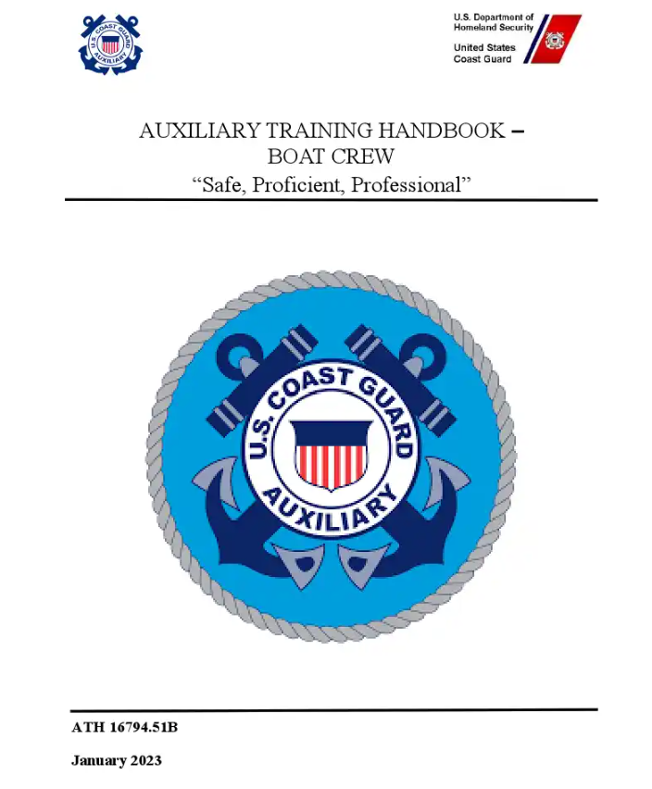
Auxiliary Training Handbook – Boat Crew (ATH-BC)
New Version “C” released on February 21, 2024
Notes:
Emphasize the fact the new handbooks were released on February 21, 2024

Slide 20
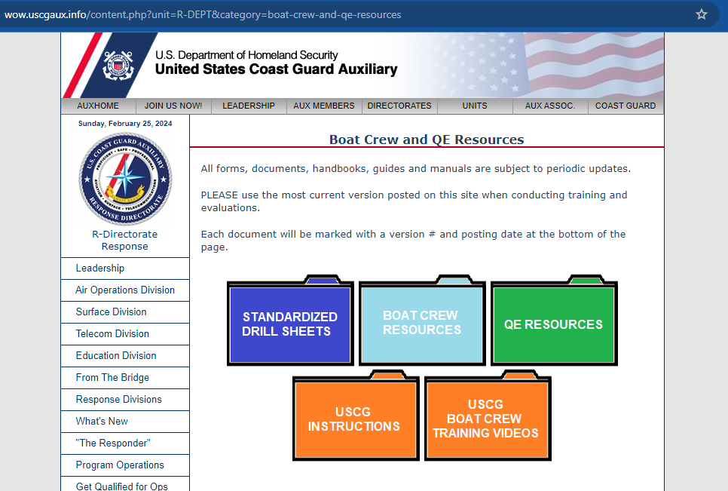
REVISED SURFACE OPERATIONS WEBSITE…..
Click anywhere in
the picture to
go to webpage
Notes:
Link to the page: https://wow.uscgaux.info/content.php?unit=R-DEPT&category=boat-crew-and-qe-resources

Slide 21
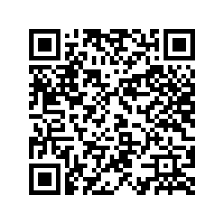
Surface Qualification Vision Check Video
Scan the QR Code below with your smartphone to access the video or click the link on the left side of the side.
https://drive.google.com/file/d/1tat5hazaTsSAn-lrJ67Ih7qLj4oMOaKB/view?usp=sharing
Notes:
Good vision and proper color vision are critical to mission safety. The video shows a simple way to ensure you (and your shipmates) are SAFE.

Slide 22
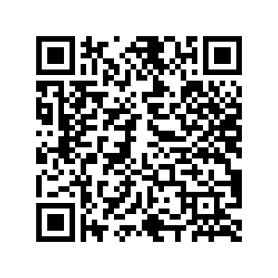
Surface Qualification Color Check Video
Scan the QR Code below with your smartphone to access the video or click the link on the left side of the side.
https://drive.google.com/file/d/1RtgdwRkLwH6KXGYRQELIf8Z9D_5FjAE8/view?usp=drive_link
Notes:
Good vision and proper color vision are critical to mission safety. The video shows a simple way to ensure you (and your shipmates) are SAFE.

Slide 23
ALAUX 032-23 Auxiliary Operations Process Guide – Vol 1
REPLACES
Auxiliary Operations Policy Manual, COMDTINST M16798.3E
CHANGES:
AUXDATA II Patrol orders approved by the OIA, with no mission activity logs, will be canceled by the system automatically 45 days after Patrol date.
Updated Patrol Order verbal orders authorization requirements.
Updated reimbursement claim submission for Patrol Order from 30 days to 15 calendar days.
Increased time from alcohol consumption to reporting for operations duty from 10 to 12 hours for all facility-related operations.
Added waivers section to include types of waivers, standards, and guidance.
Updated Personal Protective Equipment (PPE) requirements.
Added Crew Endurance Management (fatigue) standards.
Notes:
Link to the AUX OP Process Guide – Vol 1: https://wow.uscgaux.info/Uploads_wowII/BX-GROUP/Auxiliary_Operations_Process_Guide_Volume_I-General_Surface_Master.pdf

Slide 24
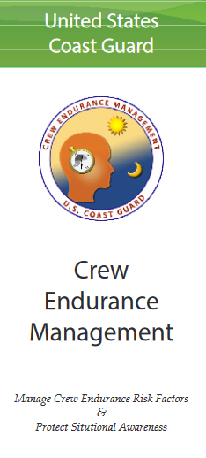
Crew Endurance Management (CEM)
Crew Endurance Management (CEM) is used to control fatigue-related degradation in safety and performance. CEM is based on operational experience, analysis of boat crew missions, and a wealth of information derived from a variety of studies on the effects of shift work on human performance.
Notes:
Stress the safety issue related to fatigue.
Ref: Chapter 10 – Section L - AUX OP Process Guide: Vol I – General/Surface
Link to the AUX OP Process Guide – Vol 1: https://wow.uscgaux.info/Uploads_wowII/BX-GROUP/Auxiliary_Operations_Process_Guide_Volume_I-General_Surface_Master.pdf

Slide 25
Crew Fatigue Time Computation
Crew fatigue time includes and is the
total cumulative of:
(01) Underway time and anchored time (100%)
(02) Pre and post‐mission activities (Codes 01D) (50%)
(03) Stops and breaks during an ordered patrol mission (Codes 01D) (50%)
(04) Trailering (Code 01B) (50%)
(05) Stand-by time (Codes 01D and 23A) (50%)
Crew fatigue time computation begins when the crew member reports to the designated place to prepare for a specific mission. Computation of such time ends when the mission is complete.

Slide 26
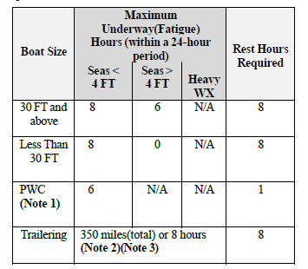
Maximum Underway Fatigue Hours
Unit Commanders and OIAs shall comply with these limits

Slide 27
Mishaps
A Coast Guard mishap is defined as any unplanned, unexpected or undesirable event that causes a termination in the mission, injury, occupational illness, death, material loss, or damage.
Mishaps are divided by class (A, B, C, D, and E) according to resulting severity of injury or cost of property damage/loss. Class A mishaps are the most serious while class D mishaps are the least severe. Class E mishaps are reserved solely for aviation.
Notes:
The AUX OP Process Guide – Vol 1 - This document provides details on how to report mishaps.
https://wow.uscgaux.info/Uploads_wowII/BX-GROUP/Auxiliary_Operations_Process_Guide_Volume_I-General_Surface_Master.pdf
Link to ALAUX 012-23 AUX Claims Process Guide – This document describes the claims process.
https://wow.uscgaux.info/Uploads_wowII/BX-GROUP/012_23_PROMULGATION_OF_THE_AUXILIARY_CLAIMS_PROCESS_GUIDE.pdf
USCG- Safety Program Management Division (CG-1131)
New Categories (2022)
The first new category is the Class E Mishap—this used to be for the aviation community only, but now it will be defined as any Coast Guard property damage from $5,000 up to $25 thousand for all communities.
The second new category is the Operational Hazard (OPHAZ) category for all communities. Operational hazards are those events or “close calls” which resulted in less than $5,000 damage or occurred without damage but had the potential to cause any damage or injury. (2022)

Slide 28
Mishap Reporting
The individual or unit with firsthand knowledge of a mishap shall immediately report all available information to the Order Issuing Authority (OIA). This reporting requirement applies to all surface mishaps, and overdue facilities. All mishaps shall be reported in accordance with COMTINST M5100.47(series).
Any noteworthy incident (positive or negative), should be reported to the DCOS to keep leadership aware of the situation.
Any additional District policies shall be followed.
Notes:
It is very embarrassing when senior leadership is approached by the Coast Guard about an incident (good or bad) and they have no idea about the incident.

Slide 29
Standard Auxiliary Maintenance Allowance (SAMA)
SAMA funding was increased by 20% in FY2023, the first increase in many years.
SAMA is meant to reimburse facility owners for routine wear and tear expenses. It is not intended to cover all costs involved in owning a facility.
Notes:
Coast Guard reimbursement examples:
The mount on your rudder wears out – your normal SAMA allowance has been giving you money towards this repair.
You hit a submerged object and your rudder is damaged – this MAY be cover by the Coast Guard as a separate expense.

Slide 30
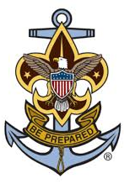
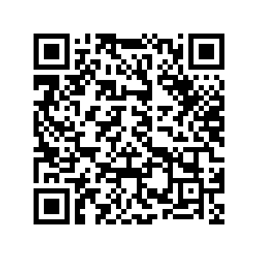
AUXSCOUT
Auxiliary-Sea Scout Youth Development Program
When involved with Sea Scouts observe all provisions of the current SOP. Scan the QR Code below with your smartphone to access the document or click the link on the left side of the side.
https://wow.uscgaux.info/content.php?unit=S-DEPT&category=auxiliary-youth-programs
Notes:
Protect the Coast Guard, the Auxiliary, and yourself by knowing and following the rules for working with minors.

Slide 31
Local Knowledge
Local information may be added here.
This slide is “turned off”, modify it as appropriate and turn it back on by right clicking on the thumbnail (left hand panel) and selecting “unhide”
You can add as many “local knowledge” slides as necessary but try to keep the overall workshop right around an hour in length.

Slide 32
Response Articles
The Response Directorate needs your help in showcasing your operations – do you have some photos and a couple sentences about an event or mission? Let’s create articles for The Responds Directorate to share your good work!
Send your pics and info to DVC-RS - Michelle.Thornton@cgauxnet.us
Notes:
If you or a shipmate did something, let the Response Directorate know and they will tell all your shipmates.

Slide 33
Operations Workshop Debrief
What went right with today’s workshop?
What could be done better next time?

Slide 34



Thank You For Your Participation!
Any feedback on the contents of this presentation may be sent to:
Division Chief – Surface COMO Michelle Thornton
Michelle.Thornton@cgauxnet.us
Roy Savoca DIR-R (Director Response)
Larry Fletcher DIR-Rd (Deputy Director Response)
U.S COAST GUARD AUXILIARY - UNCLASSIFIED
41

