Slide 1
New Uniform Inspection.
Auxiliary Manual Section Chapter 10.Section C.1. -
Setting an Example and Uniform Inspection Requirements
Elected and appointed officers are expected to wear the uniform properly to set an example. They must motivate and inspire other Auxiliarists to maintain the highest standards of personal appearance, hygiene, and grooming when wearing the uniform. They must also hold the membership accountable for maintaining the same high standards. Accordingly, the following provisions in this section are effective beginning in CY 2024.
Seventh District Member Training

Slide 2
A uniform inspection is required to:
Advance from BQ (Basic Qualification) to AX (Operational Auxiliarist.)
Most certifications.
To remain out of REYR (required yearly not met.)
To participate in operations or events that require a uniform to be worn.

Slide 3
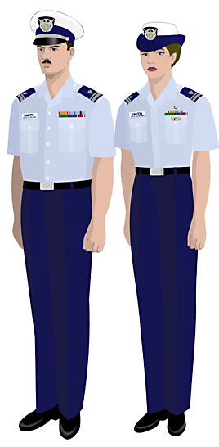
Looking Good in Tropical Dress Uniform (Trops)

Slide 4
Auxiliarists in a membership status other than Approval Pending (AP) or retired shall undergo a uniform inspection each calendar year. This inspection is performed and validated for AUXDATA II entry purposes by their FC, VFC, IPFC, or other elected officer (i.e., this includes other immediate past elected officers) in their Chain of Leadership and Management.

Slide 5
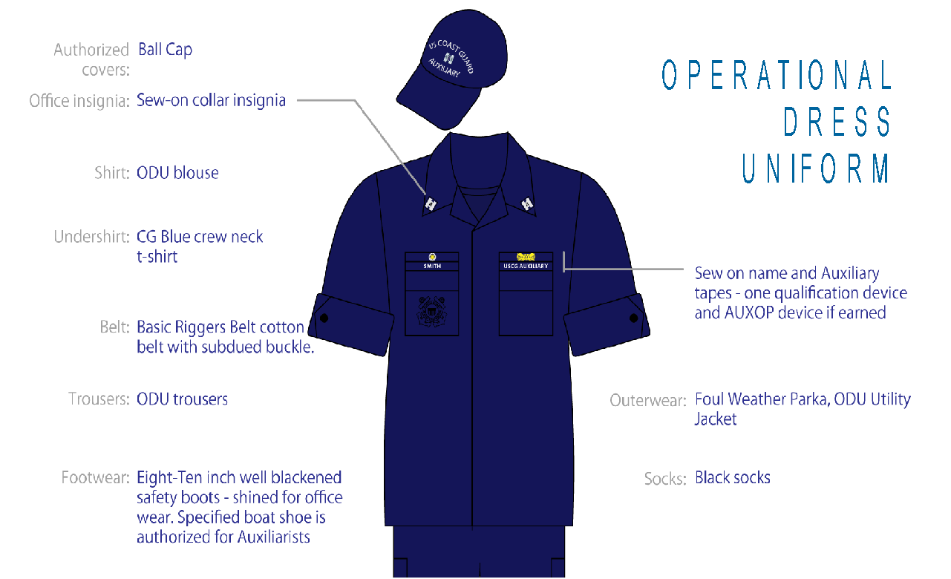
Proper Operational Dress Uniform (ODU) Wear.

Slide 6
Undergoing inspection by an elected or immediate past elected officer in another Auxiliary COLM is also authorized. For example, an Auxiliarist may undergo their uniform inspection in another Auxiliary region while away from their home (e.g., at the annual Auxiliary National Training Summit). In such a case, the Auxiliarist must provide the inspector’s attestation of inspection to their FC for AUXDATA II record entry purposes (email acceptable).

Slide 7
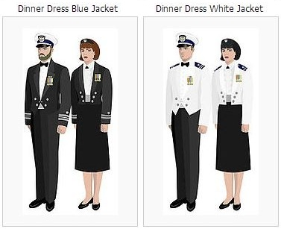
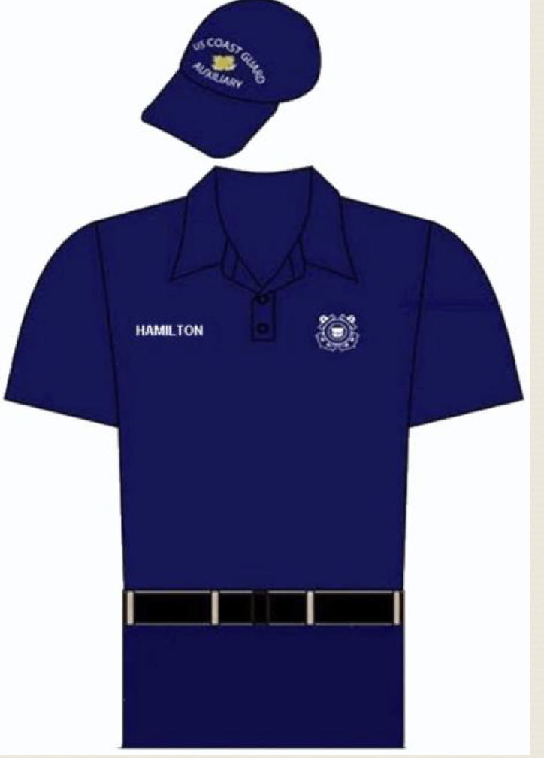
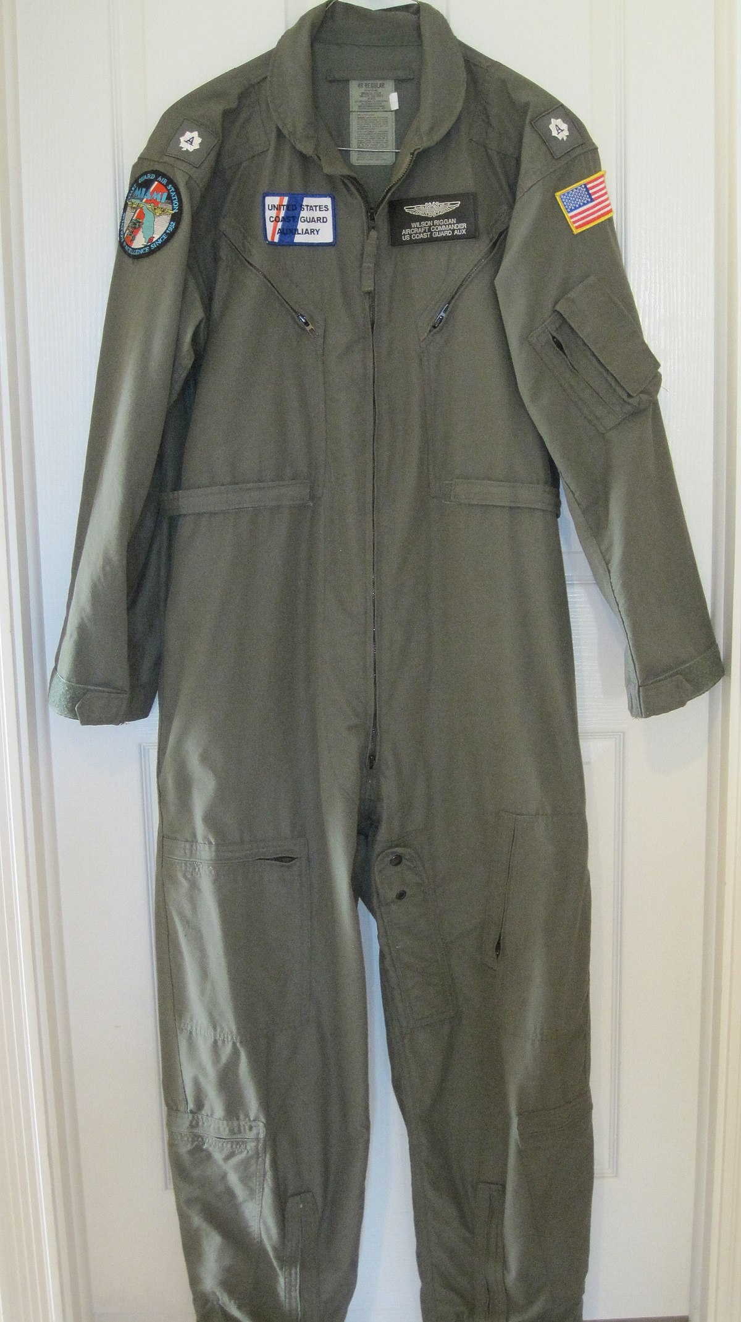
Not for Inspection.
Those authorized to perform uniform inspections may not specify the uniform to be worn. Dinner Dress Jacket uniforms, Hot Weather Uniform (HWU) versions, the Auxiliary jump suit, flight suit, or any organizational clothing (defined as Coast Guard unit-owned clothing that is issued to individuals) are not authorized for the purpose of this annual inspection.

Slide 8
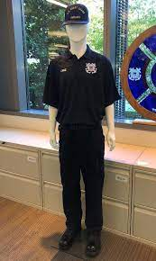
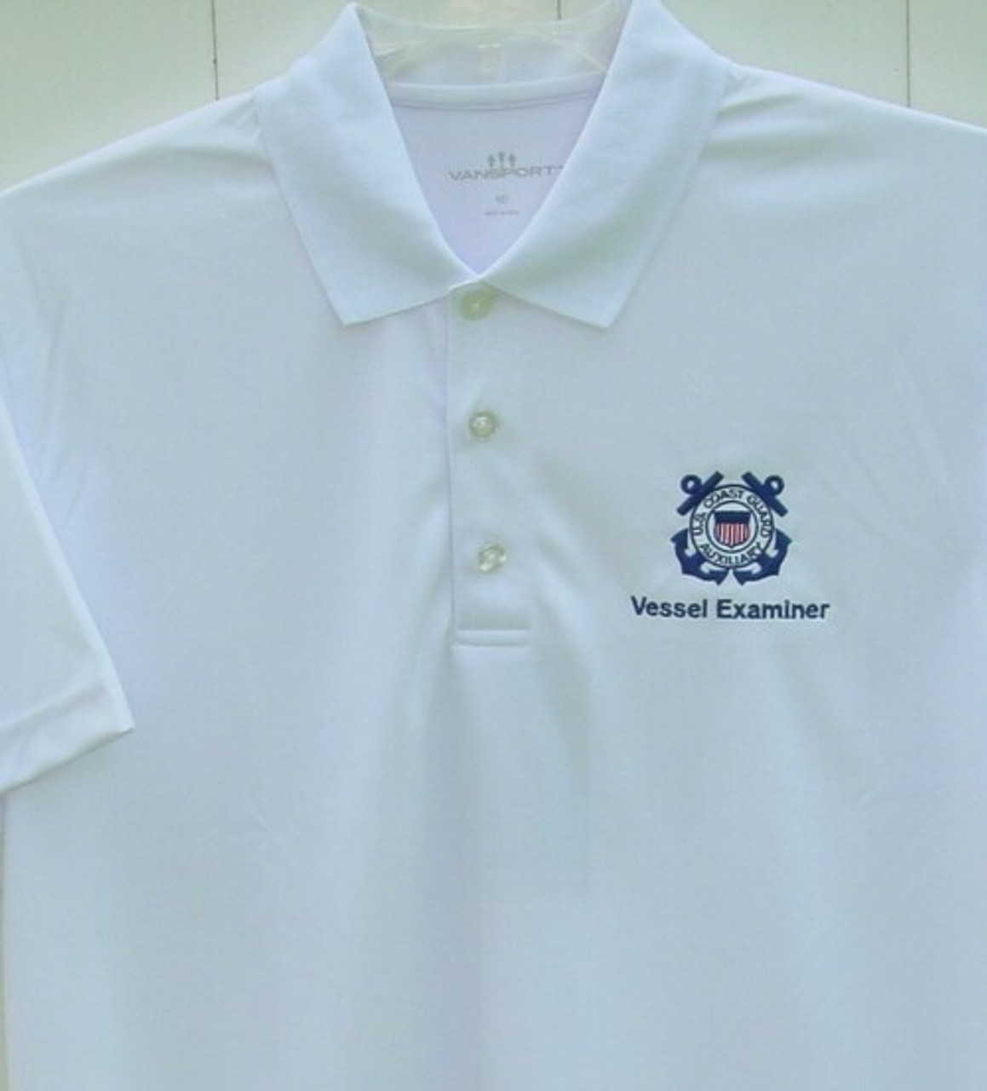
Authorized for Inspection.
In addition to the above Trops and ODU, the Alternate Work Uniform (AWU) is authorized. VE polo is also authorized.

Slide 9

Flexibility shall also be afforded Auxiliarists to undergo inspection. Multiple opportunities for inspection shall be provided (e.g., flotillas and divisions should hold inspection opportunities at meetings). The inspected Auxiliarist shall be immediately advised of any discrepancies stemming from their inspection to correct them as soon as possible.
Semper Gumby

Slide 10
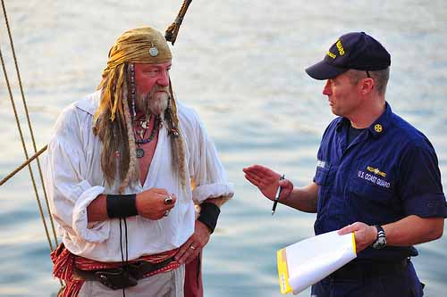
Opportunities to correct discrepancies.

Slide 11
Inspections shall include presentation and review of an Auxiliarist’s ID card. If the Auxiliarist’s ID card is expired or the photo no longer resembles their appearance, it is the Auxiliarist’s responsibility to obtain a new ID card as soon as possible after inspection. If the inspection is performed by photo(s) or virtually, the Auxiliarist may sanitize the ID card blocks for Date of Birth and Blood Type before mailing or displaying it.

Slide 12
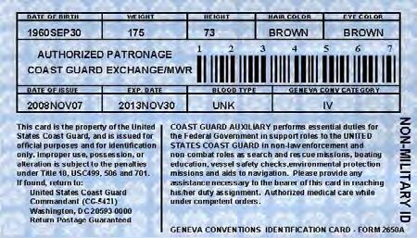

Slide 13
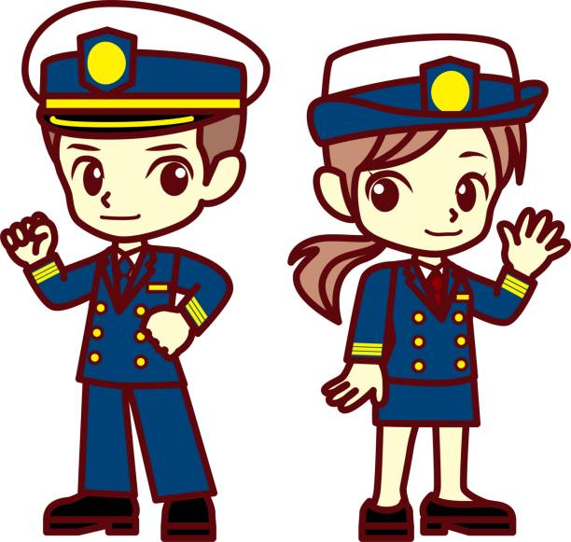
Annual inspection shall count as an annual currency maintenance task applicable to all Auxiliary competencies. Auxiliarists are encouraged to pursue its completion as early in the calendar year as possible and to be inspected in a different uniform they are authorized to wear each year to confirm they are wearing all their authorized uniforms properly.

Slide 14
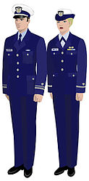
Keeping up the Image in Service Dress Blue.

Slide 15

All Auxiliarists, particularly those in leadership positions, are expected and have the responsibility to render judgments and take appropriate action regarding adherence to the Coast Guard’s high standards of appearance. This is of particular importance in the context of the serviceability of uniform items worn by themselves and their fellow Auxiliarists.
Remember, Praise in Public!
Correct in Private!

Slide 16
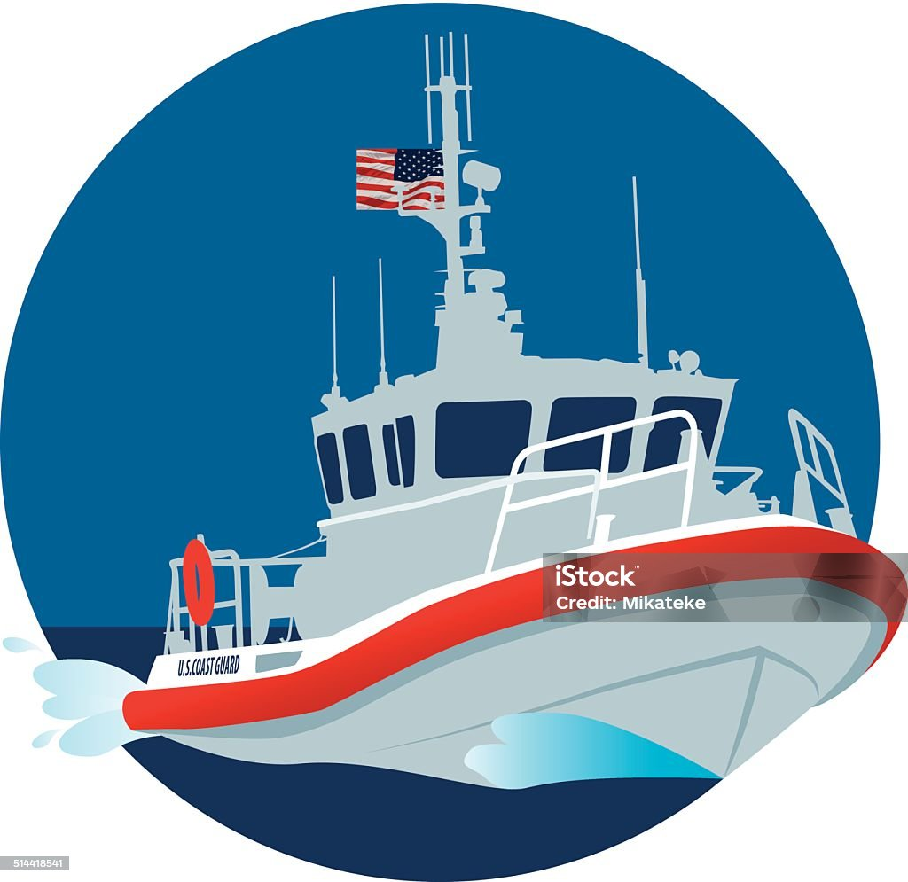
Thank you for taking pride in the uniform we have the privilege to wear.
We are seen as the Coast Guard, and we need to uphold that image.

