Slide 1
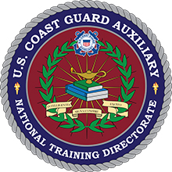
U.S. Coast Guard Auxiliary Instructors.
Seventh District Member Training

Slide 2
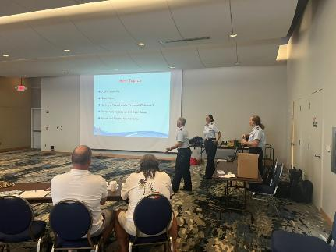
So, you want to help through education?
Being an Instructor in the U.S. Coast Guard is one of the best ways to help save lives!

Slide 3
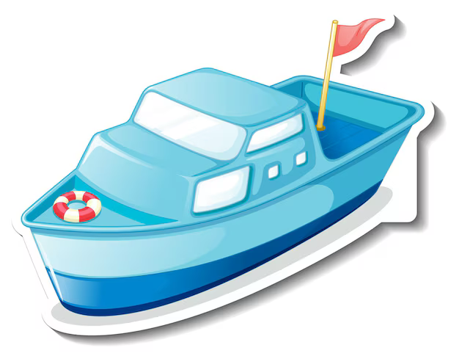
Public Education Courses Our outreach to the boating public.

Slide 4

Suddenly in Command!
What now?
Excellent for groups like yacht clubs, condo groups, boat clubs, etc.
Two hours maximum.
Not a certificate course.

Slide 5

An Introduction to Basic Boating Safety Seminar.
An introduction for new boat owners. One hour. Not a certificate course.

Slide 6
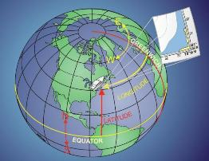
The Global Positioning System – GPS.
“It’s Everywhere”
GPS:
Currently the primary means of navigation on the water.
Accurate and world wide.
Users need to be familiar with the unit on their boat.

Slide 7

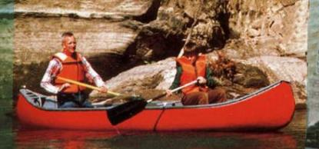
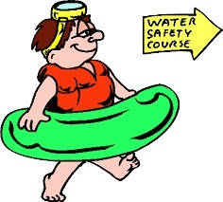
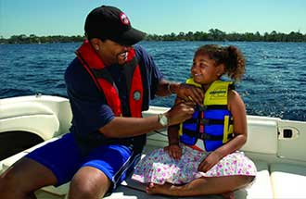
Water N’ Kids. Water Safety Program.

Slide 8
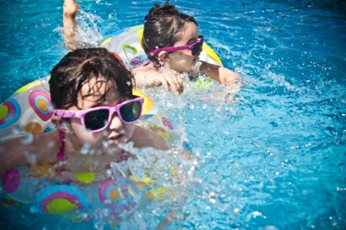
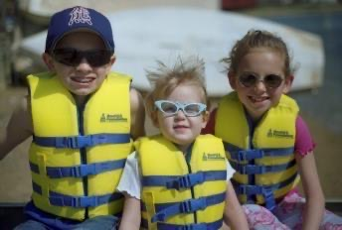
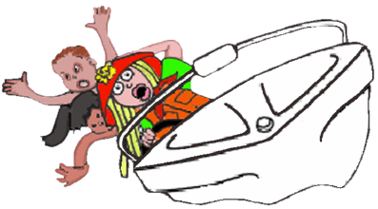
Excellent course for younger kids. Lots of chances to have interaction and participation.

Slide 9
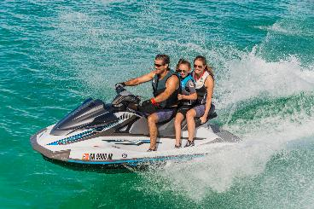
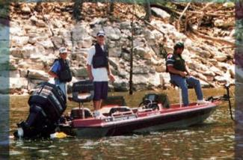
Waypoints.
A Guide to Boating Safely.

Slide 10

Great program for elementary school ages, Scout groups, etc.

Slide 11
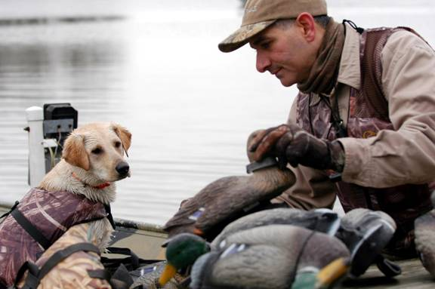
Waterfowl Hunting and Boating Safety.

Slide 12

Great for hunting clubs.
Sporting goods stores.
Gun clubs.

Slide 13
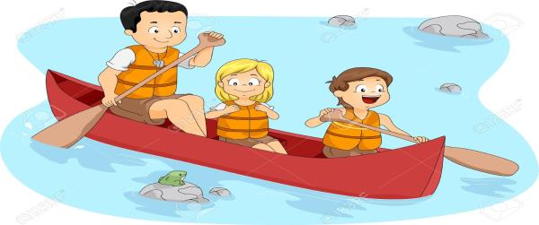
A Guide to Safe Paddle Craft:
canoes, kayaks, and SUPs.

Slide 14
This is a paddlecraft presentation geared to younger groups.
Good for schools, summer camps, etc.

Slide 15
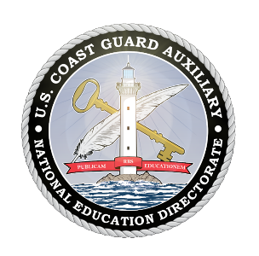


A Paddler’s Guide to Safety.
U.S. Coast Guard Auxiliary, in cooperation with the American Canoe Association.

Slide 16
Geared to a more adult audience.
Uses American Canoe Association material.
Longer class, approximately two to three hours.

Slide 17
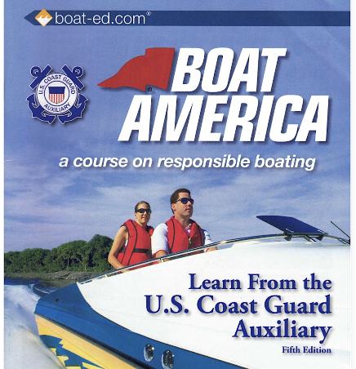
Boat America.
A course on responsible boating.

Slide 18
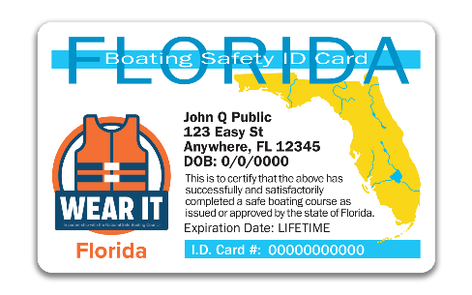
NASBLA.
National Association of State Boating Law Administrators
Eight-hour course
Six chapters for all states, one chapter for your state.
Earns the boater safety ID card.

Slide 19
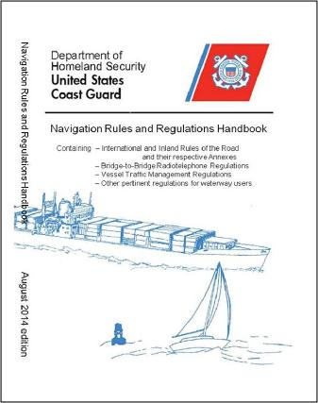
Nav Rules “Lite” for Recreational Boaters.
Richard G. Heller, J.D., Ph.D., Public Education Instructor
U.S. Coast Guard Auxiliary, District 11sr
© 2014
Note well: Every recreational boater should own the latest printed version of the Navigation Rules and read them cover to cover. This brief presentation is no substitute for the actual rules themselves. The purpose of this brief presentation is to encourage you to purchase a copy of the actual rules and read them in their entirety!

Slide 20
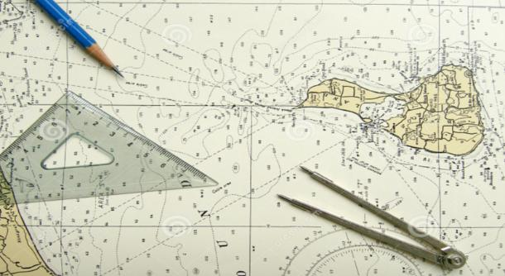
Weekend Navigator.
Several sessions covering navigation in-depth.
More Advanced.

Slide 21
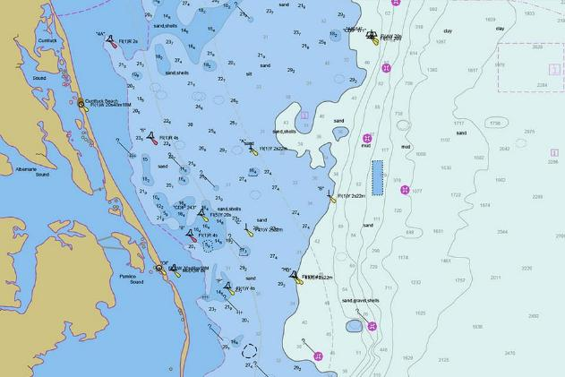
This is a great introduction to navigation on the water.

Slide 22
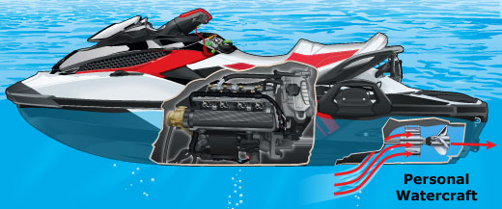
Personal Watercraft (PWC) Safety.
Having a fun and safe experience.

Slide 23
Great for new and experienced operators.
Personal watercraft operators and renters.
Approximately two hours covering a wide range of topics.

Slide 24
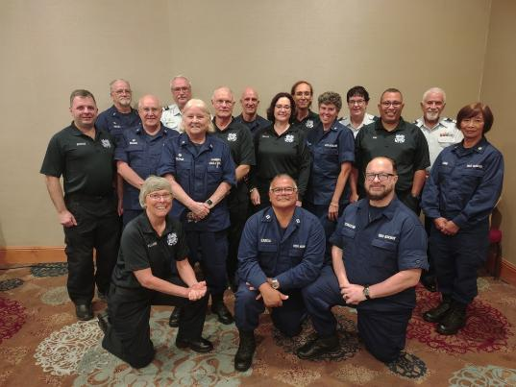
Member Training.
As an Auxiliary instructor you help your fellow shipmates through Member Training.

Slide 25
Member Training opportunities
Uniforms
AuxData II
Chain of Leadership and Management. (COLM.)
Workshops
Core Training (In-person.)
New Members
Recruiting

Slide 26
More member training.
Leadership courses.
Culinary.
Air Crew.
The list goes on!

Slide 27
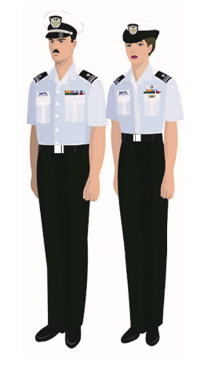
Enthusiasm, Engagement, Excellence.

Slide 28

Instructors.
Whether Public Education or Member Training, you are the face of the

Slide 29
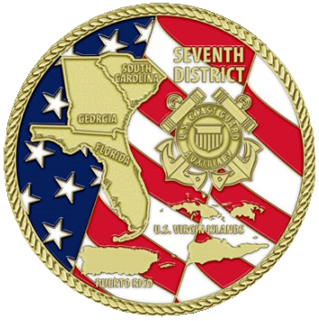
U.S. Coast Guard Auxiliary Seventh District
Member Training Team.

